Slide 1


EBU4202: Digital Circuit Design
Introduction to Lab 2 & 3
Dr. Md Hasanuzzaman Sagor (Hasan)
Dr. Chao Shu (Chao)
Dr. Farha Lakhani (Farha)
School of Electronic Engineering and Computer Science,
Queen Mary University of London,
London, United Kingdom.

Slide 2
General Requirement
Before attending the lab.
The lab sheets will be made available before the lab sessions
Read the lab sheet through
Complete at least the questions in the ”Preparatory Work”.
We encourage you to complete as many questions in the lab sheet as you can before
Note for the Lab
If you wait till the lab session to do the preparation, you will not have enough time to complete the lab.
The completed lab sheets must be handed in at the end of the lab session. Late submissions will not be accepted, resulting in a score of 0!

Slide 3
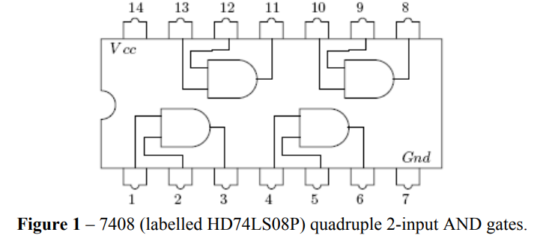
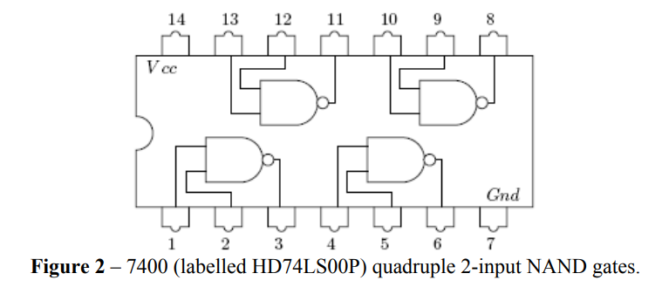
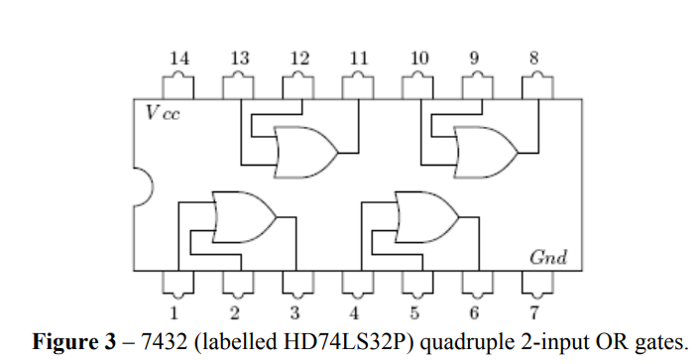
ICs you will use

Slide 4
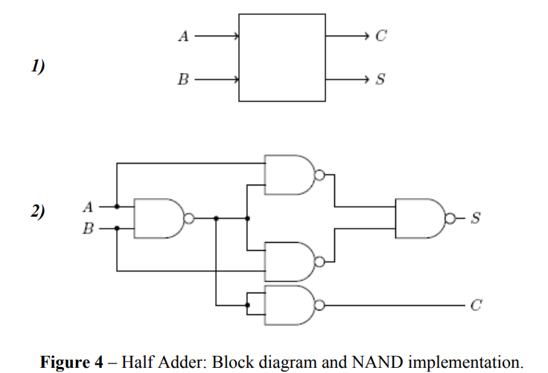
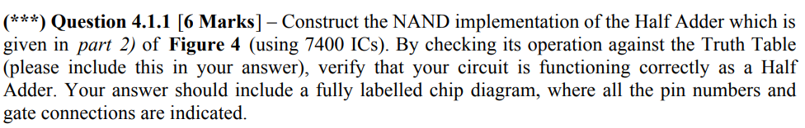
Experiment 1
Implementation of Half Adder using NAND gate
Must show your work to TA

Slide 5
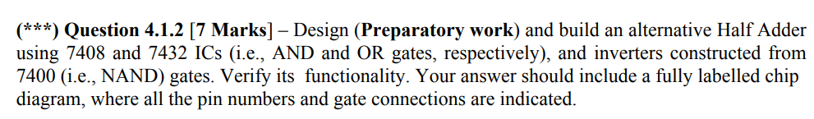
Experiment 1
Alternate implementation of Half adder
Must show your work to TA

Slide 6
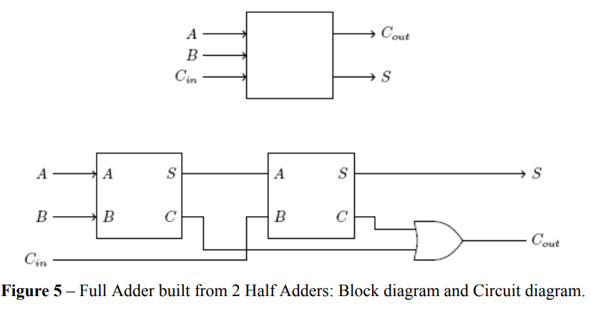
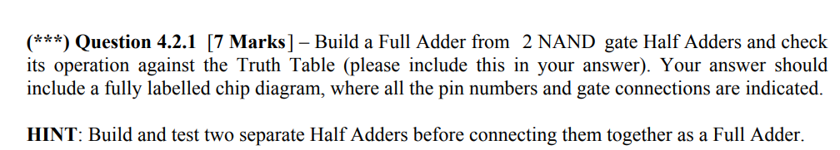
Experiment 2
Implementation Full adder
Must show your work to TA

Slide 7
Lab 3: Sequential Circuits
Note for the Lab
Do all the background design work for Experiments 1 and 2, and produce properly numbered circuit diagrams where indicated. You should do all the Preparatory Work before the Lab Session takes place.
Please note that all the circuits you build during this experiment will require the Test Bench previously described in Lab Sheet 1; you need to assemble this before you start your experiments.

Slide 8
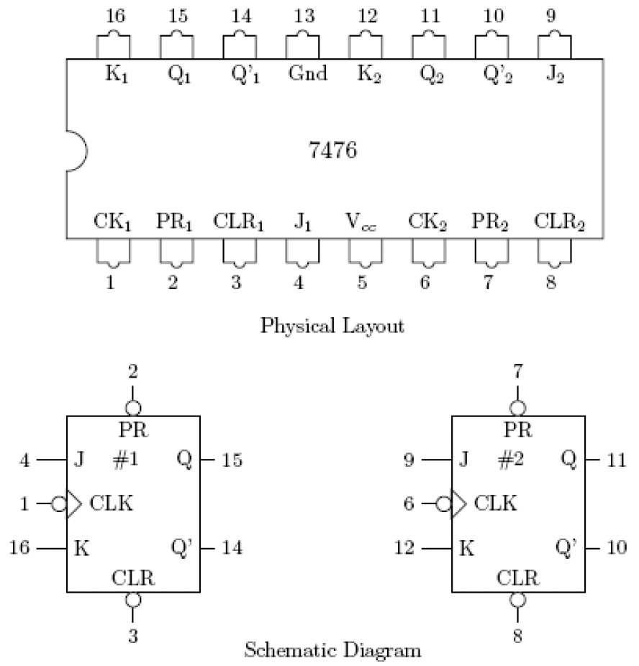
Lab 3: New IC
New chip to be used
2 x 7476 (labelled HD74LS76P) Dual JK flip-flops with preset and clear. (For experiment 2 only)

Slide 9
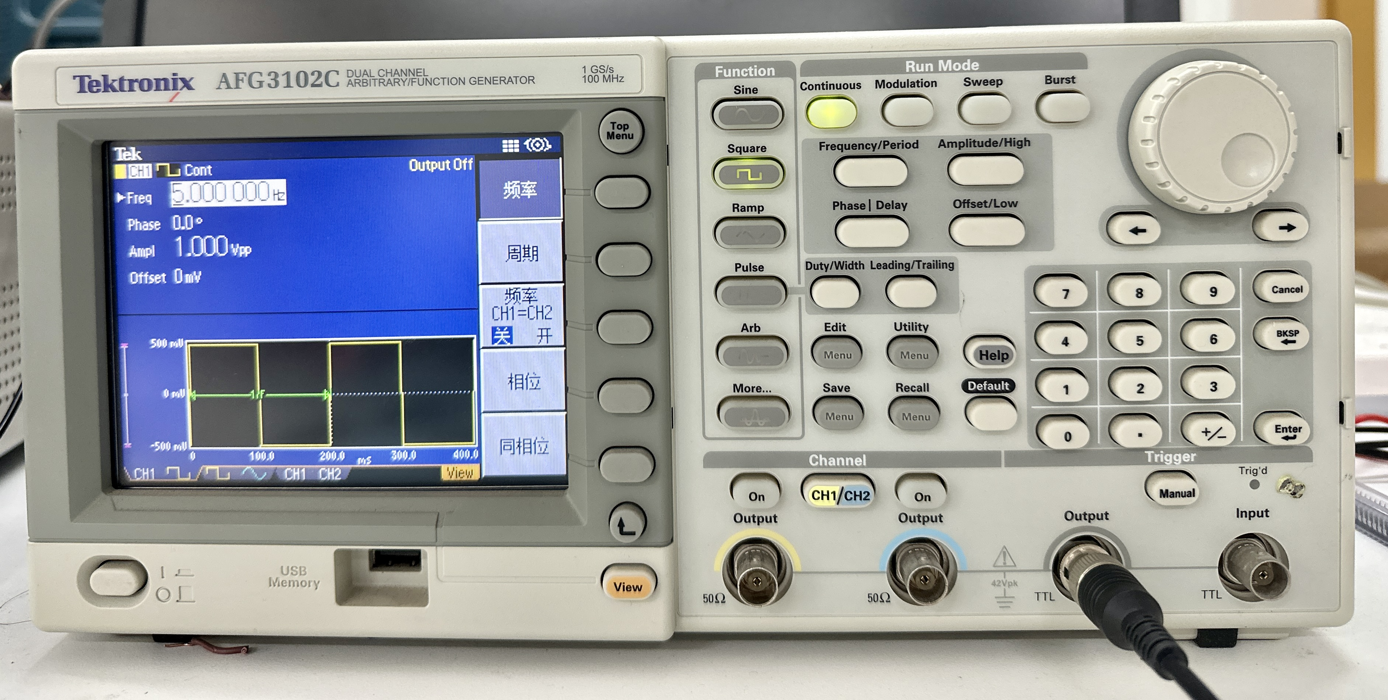
Lab 3: New Instrument
Function Generator / Oscillator with TTL output
Square Wave
TTL Output Port
To set the clock frequency. You can set other parameters as well such as amplitude, phase, offset, duty cycle, etc.

Slide 10
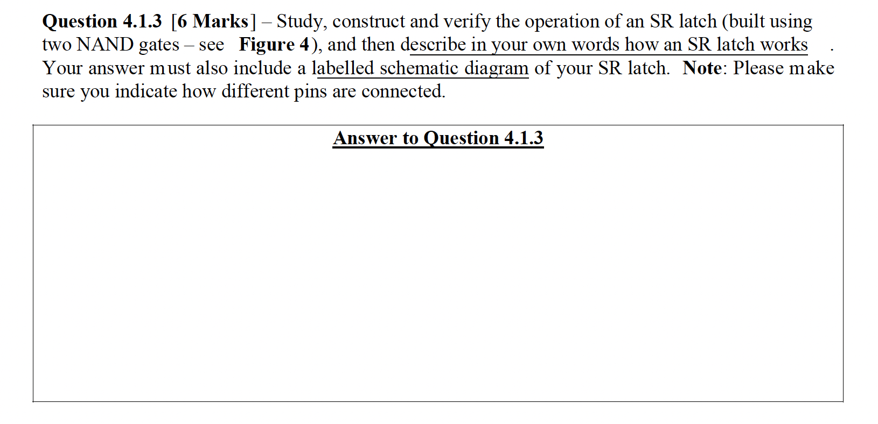
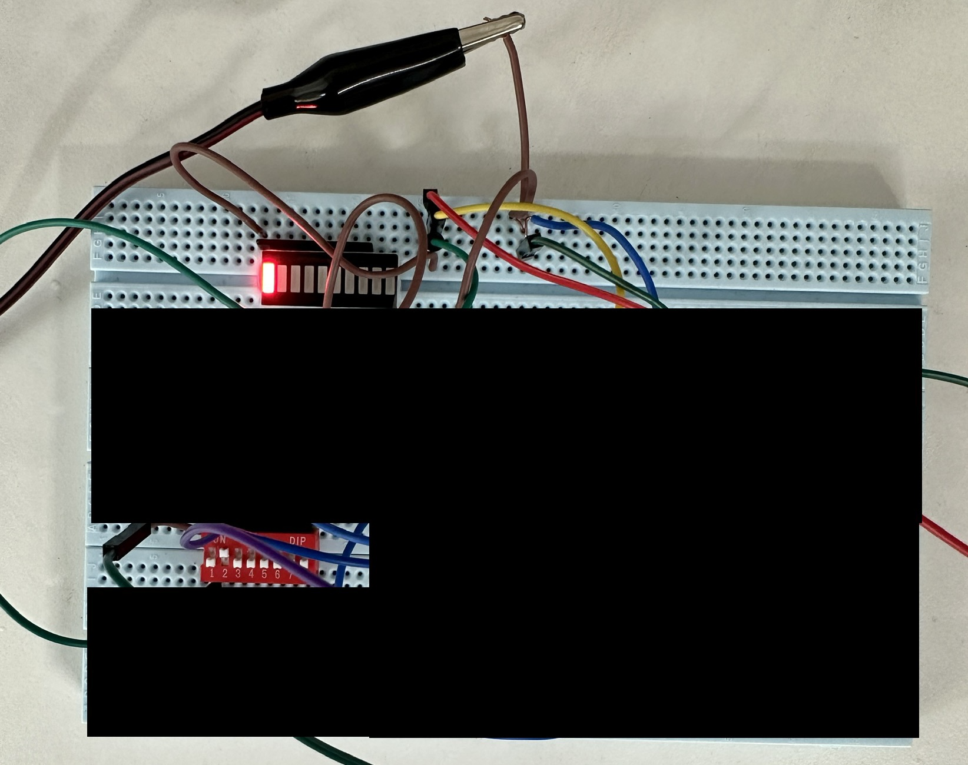
Lab 3: Experiment (SR & D Latches)
Demonstrate this completed task to one of the TAs for verification
Providing Q=1
when S’ = 1.

Slide 11
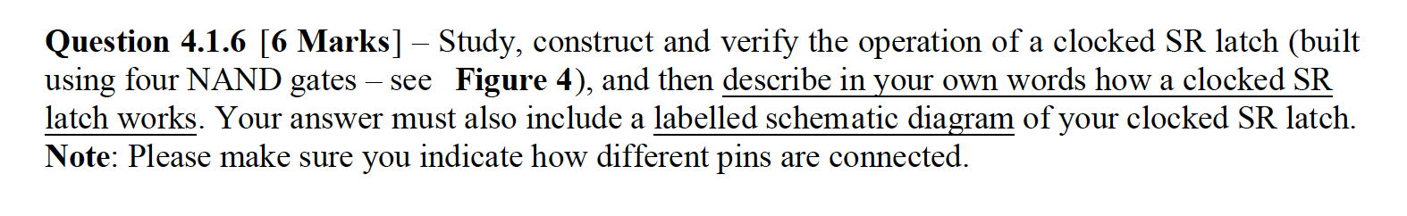
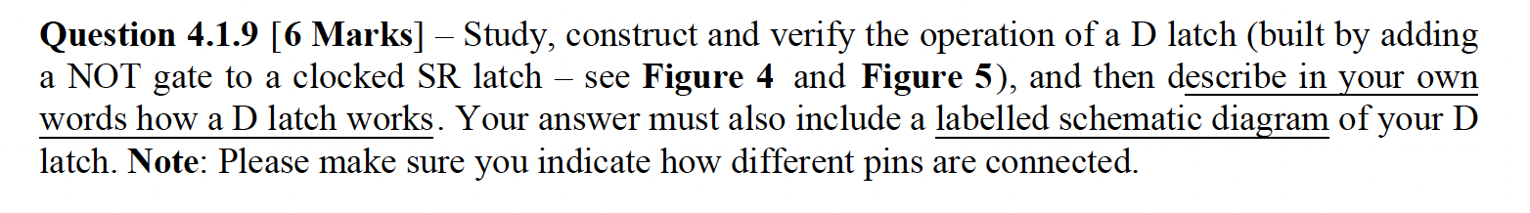
Lab 3: Experiment (SR & D Latches)
Demonstrate this completed task to one of the TAs for verification
*SR latch design with 4 NAND Gates
D latch (built by adding a NOT gate to a clocked SR latch)

Slide 12
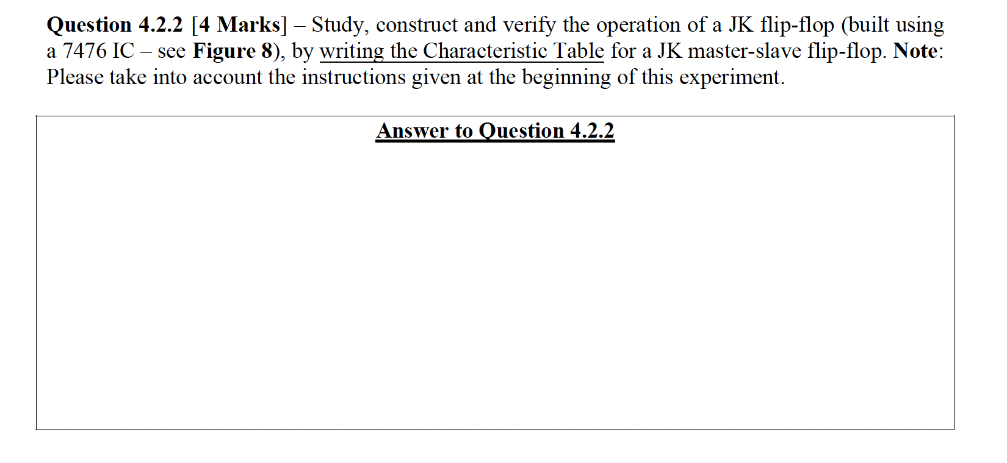
Lab 3: Experiment (JK Flip-flop)
Demonstrate this completed task to one of the TAs for verification
Verify the operation of a JK flip-flop writing the Characteristic Table

